Slide 1

SECURE CRIME RECORD SHARING USING DATA HIDING WITH CRYPTOGRAPHY APPROACH
BATCH NO:00
PROJECT MEMBERS
Bharathraaj.B 812419104007
Emmanuel.A 812419104017
Rahul.V 812419104050
PROJECT GUIDE
Mr A Joshua Issac, M.E.,
Assistant Professor
Department of Computer Science and Engineering

Slide 2
OBJECTIVE
To track fake crime information using LSB based image stegnography approach to analyze whether the crime record is original or not.

Slide 3
INTRODUCTION
Multimedia data sharing is increasingly becoming an essential part of the daily life for end users to access different systems, services, and applications.
Data disclosure frequently occurs in real-world cloud storage services.
Network security focus on embed security in the cloud-based media sharing service.

Slide 4
LITERATURE SURVEY
S.No | Title | Author &Year | Technique | Merit | Demerit
1. | A blockchain and smart contract-based data provenance collection and storing in cloud environment | Jyoti, Amrita.2022 | Blockchain and smart contract-based data provenance (BSCDP) Architecture | The proposed work improves the privacy and security of data in the cloud environment. | A fingerprint, like a password, is difficult to copy and store. However, if it is lost, the user’s fingerprint information is leaked.
2. | A transparent and privacy-preserving healthcare platform with novel smart contract for smart cities | Al Omar, Abdullah, Abu Kaisar Jamil, Shahriar Rahman. 2021 | Propose a solution for the healthcare system using blockchain technology that provides data privacy and transparency. | Patients can also preserve healthcare data securely in the cloud, and their identity information in the blockchain. | There exist few differences according to their purpose and capacities. To use the ethereum network, users need to pay a fee.

Slide 5
LITERATURE SURVEY
S.No | Title | Author &Year | Technique | Merit | Demerit
3. | An incentive-compatible rational secret sharing scheme using blockchain and smart contract | Chen, Zerui, Youliang Tian, and Changgen Peng. 2021 | Propose an incentive-compatible rational secret scheme. | Use blockchain smart contract to control the utility functions of rational players. | For players in secret sharing, their secrets need to be hidden. The data on the blockchain is visible to the public.
4. | An incentive mechanism for data sharing based on blockchain with smart contracts | Xuan, Shichang, Li Zheng, Ilyong Chung, Wei Wang, Wu Yang, and Mohsen Guizani. 2020 | Proposes a data sharing incentive model based on evolutionary game theory using blockchain with smart contract. | Proposed system should encourage users to actively share data. | Each user shares data and can also receive data shared by other users that increases the difficulties.

Slide 6
LITERATURE SURVEY
S.No | Title | Author &Year | Technique | Merit | Demerit
5. | OBFP: Optimized blockchain-based fair payment for outsourcing computations in cloud computing | Lin, Chao, Debiao He, Xinyi Huang, and Kim-Kwang Raymond Choo. 2021 | Propose a system model of an optimized blockchain-based fair payment (OBFP) for outsourcing computations. | OBFP works more fair with a lower executing cost for being adopted into the outsourcing computations. | Users may maliciously drop out without paying for the execution.

Slide 7
EXISTING SYSTEM
The Crime report contain crucial information such as the victim's name, the accused's name, the type of crime committed, the location of the crime, and other relevant details.
The criminal database is maintained by central Headquaters in several levels of accessing any case.

Slide 8
ISSUES IN EXISTING SYSTEM
Crime record management typically involves manual record-keeping processes, which are time-consuming, error-prone, and difficult to manage.
The manual record-keeping system is often disorganized, difficult to access or retrieve data quickly.
This can lead to delays in decision-making and affect the ability of law enforcement to respond to crime effectively.

Slide 9
PROPOSED SYSTEM
The need for secure and efficient methods for managing and sharing crime data is paramount in today's society.
The aim of this is to ensure that only authorized individuals can access the data.
Multi-secret sharing based image encryption is a promising technique for securing data, which involves dividing the image into multiple shares and distributing them to the
authorized receiver.

Slide 10
ADVANTAGES
Proposed approach provides efficient method for protecting sensitive crime data.
By using image encryption techniques, it is possible to reduce the size of the data being stored, making it more efficient and easier to manage.
By hiding the crime data within a criminal face image, it is possible to maintain the anonymity of the individuals involved.

Slide 11
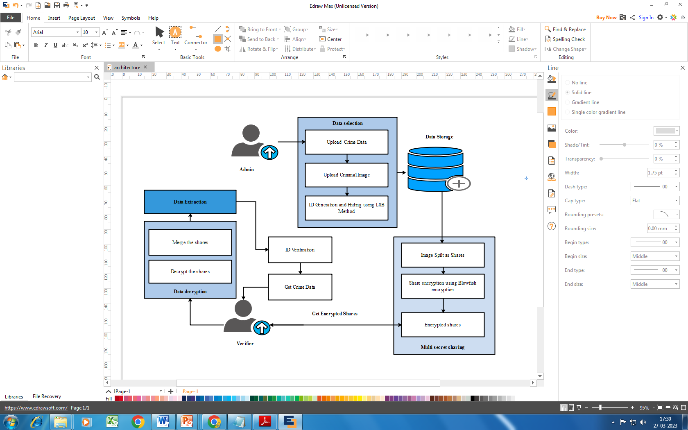
PROPOSED SYSTEM ARCHITECTURE

Slide 12
SYSTEM REQUIREMENTS
HARDWARE CONFIGURATION
Processor : Intel Core Processor 2.71GHz
RAM : 2 GB
Hard disk : 1000 GB
Compact Disk : 650 Mb
Keyboard : Standard keyboard
Monitor : 15 inch color monitor

Slide 13
SYSTEM REQUIREMENTS
SOFTWARE CONFIGURATION
Operating system : Windows OS
Front End : PYTHON
Back End : MYSQL
Application : Web Application
IDE : PYCHARM

Slide 14
MODULES
FRAMEWORK CONSTRUCTION
CRIME DATA HIDING WITHIN IMAGE
IMAGE FRAGEMENATION
IMAGE ENCRYPTION
INTEGRITY VERIFICATION

Slide 15
MODULES DESCRIPTION
Framework Construction
Crime data sharing is crucial for law enforcement agencies to effectively combat criminal activities.
Sharing sensitive crime data poses a significant security challenge as it can be intercepted or leaked.
Propose a novel approach that combines steganography, multi-secret sharing, and encryption to securely share crime data among law enforcement agencies.

Slide 16
MODULES DIAGRAM
Admin
Crime Data Sharing Framework
Database
Verifier

Slide 17
MODULES DESCRIPTION
Crime Data Hiding within Image
Hiding crime data within criminal images using Least Significant Bit (LSB) is a common technique used in digital forensics and data encryption.
Here generate unique ID for crime information and embed the ID to the cover image.
The LSB technique involves replacing the least significant bits of the pixels in an image with the data that needs to be hidden.
Since the least significant bits of the pixels have a minimal impact on the overall image quality, the hidden data is not easily detectable.

Slide 18
MODULES DIAGRAM
Input: Crime Data
Generate Unique ID
Input: Criminal Image
ID hiding in Image
Apply LSB Technique
Output: Stegno Image

Slide 19
MODULES DESCRIPTION
Image Fragmentation
Image fragmentation is a technique used in multi-secret sharing schemes to divide an image into multiple pieces,
Each share can be separately encrypted and distributed to different parties.
This technique is used to ensure that no single party can gain access to the complete image without the cooperation of all the other parties involved.

Slide 20
MODULES DIAGRAM
Input: Stegno Image
Image Fragmentation
Apply Multi Secret Sharing
Image Split into Random shares
Output: Image Shares

Slide 21
MODULES DESCRIPTION
Image Encryption
Blowfish approach is designed to improve the safety of the images but also to enhance the efficiency.
This algorithm uses a variable key of size up to 448 bits.
The blowfish algorithm is opposed to illegal attacks and works much more faster and efficient than the other algorithms.
Here, the data bit stream of the primary image is split into the limit of the block of the Blowfish algorithm.
Then with the help of a key and encryption algorithm, the initial image is encrypted which is not visible to anyone.

Slide 22
MODULES DIAGRAM
Input: Image Share
Image Encryption
Apply Blowfish Algorithm
Key Generation & Encryption
Output: Encrypted Shares

Slide 23
MODULES DESCRIPTION
Integrity Verification
This module explains about the process of detecting the crime information is true or fake.
Verifier can check whether the user’s ID card is valid or not.
Data extraction is the process of extracting the embedded information from cover file.
In proposed application system will automatically check the embedded ID number with user’s original ID number.
If numbers are same, it will consider as the original crime information. Otherwise consider the shared information was fake.

Slide 24
MODULES DIAGRAM
Input: Encrypted Image Shares
Share Decryption
Image Reconstruction
Extract ID & Verification
Output: Fake Detection
Output: Get Original Data

Slide 25
CONCLUSION
The approach of secure crime data sharing using data hiding with multi-secret sharing has shown promising results in terms of enhancing the security and privacy of sensitive crime data.
By embedding crime data within images using the LSB technique and then sharing the resulting steganographic images using a multi-secret sharing approach, it is possible to ensure that only authorized personnel with access to all the shares can retrieve the original data.

Slide 26
FUTURE ENHANCEMENT
Proposed approach is still susceptible to attacks if one or more shares are compromised.
Therefore, more advanced multi-secret sharing schemes that can detect and recover from such attacks should be explored.
Further research is required to optimize and improve the approach before it can be deployed in real-world scenarios.

Slide 27
REFERENCES
[1] Jyoti, Amrita, and R. K. Chauhan. "A blockchain and smart contract-based data provenance collection and storing in cloud environment." Wireless Networks 28, no. 4 (2022): 1541-1562.
[2] Al Omar, Abdullah, Abu Kaisar Jamil, Amith Khandakar, Abdur Razzak Uzzal, Rabeya Bosri, Nafees Mansoor, and Mohammad Shahriar Rahman. "A transparent and privacy-preserving healthcare platform with novel smart contract for smart cities." Ieee Access 9 (2021): 90738-90749.
[3] Chen, Zerui, Youliang Tian, and Changgen Peng. "An incentive-compatible rational secret sharing scheme using blockchain and smart contract." Science China Information Sciences 64 (2021): 1-21.
[4] Xuan, Shichang, Li Zheng, Ilyong Chung, Wei Wang, Dapeng Man, Xiaojiang Du, Wu Yang, and Mohsen Guizani. "An incentive mechanism for data sharing based on blockchain with smart contracts." Computers & Electrical Engineering 83 (2020): 106587.
[5] Lin, Chao, Debiao He, Xinyi Huang, and Kim-Kwang Raymond Choo. "OBFP: Optimized blockchain-based fair payment for outsourcing computations in cloud computing." IEEE Transactions on Information Forensics and Security 16 (2021): 3241-3253.

